Slide 1
Boundary Value Problems And Partial Differential Equations
Burden & Faires 11.3, 12.1-12.2

Slide 2

Differential Equations
Models capturing physics (sum of forces equals mass times acceleration), mechanics, chemical concentrations. Changing in time and/or space)
Why do we need to numerically approximate?
Initial Value Problem y’=f(t,y) y(t_{o})=y_{o}
Boundary Value Problem y’’+y’=f(x,y) y(a)=y_{a} and y(b)=y_{b}
Could have: systems of differential equations, nonlinearities, complex boundary or initial conditions, …

Slide 3
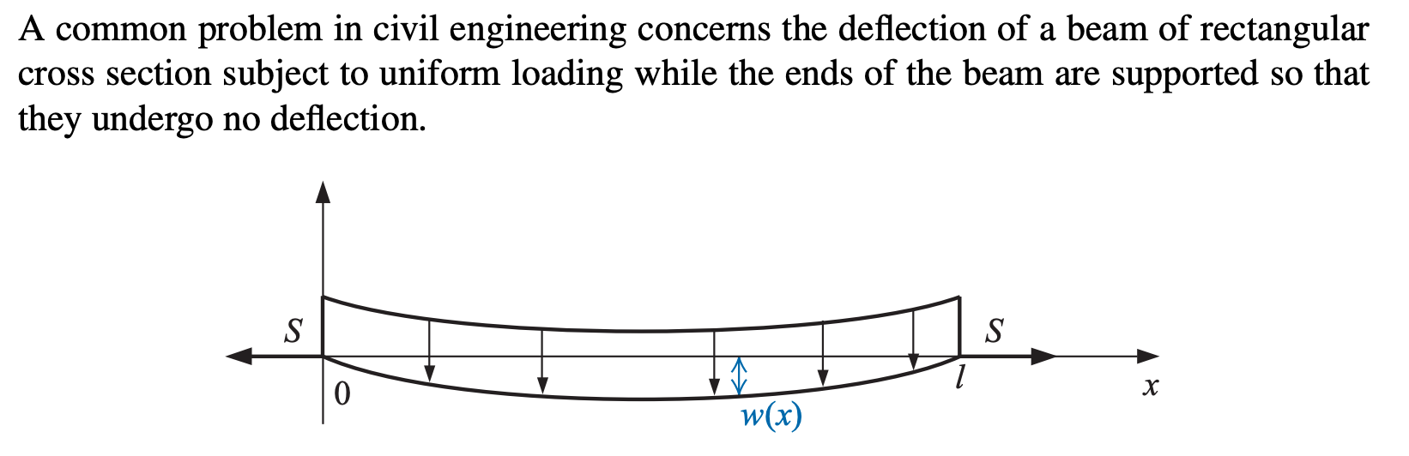
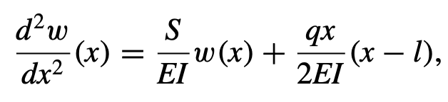
Boundary Value Problems

Slide 4
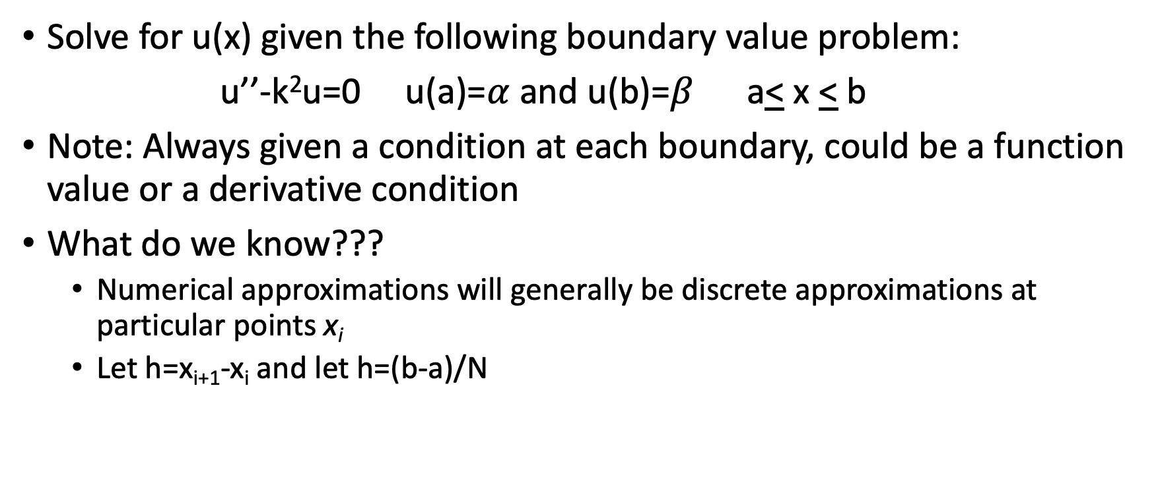

Boundary Value Problem
Solve for u(x) given the following boundary value problem:
u’’-k²u=0 u(a)=$α$ and u(b)=$β$ a< x < b
Note: Always given a condition at each boundary, could be a function value or a derivative condition
What do we know???
Numerical approximations will generally be discrete approximations at particular points x_{i}
Let h=x_{i+1}-x_{i} and let h=(b-a)/N

Slide 5
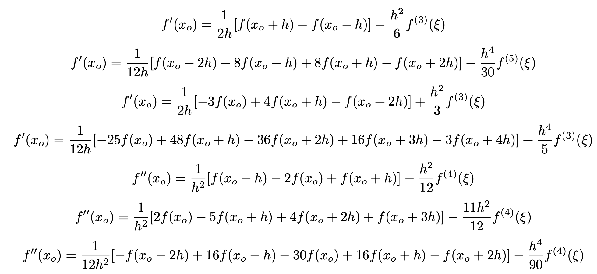
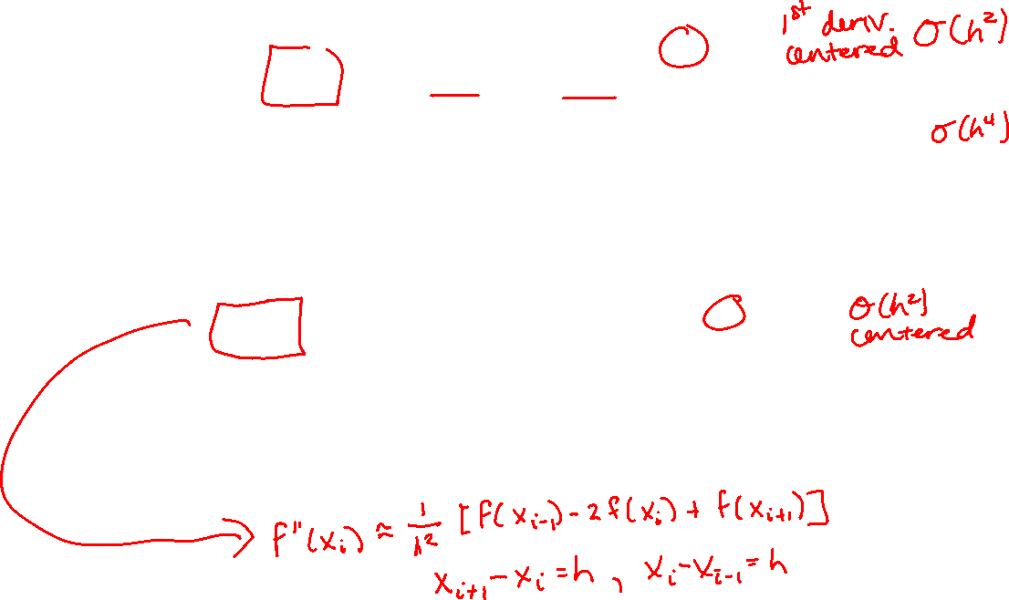

Slide 6

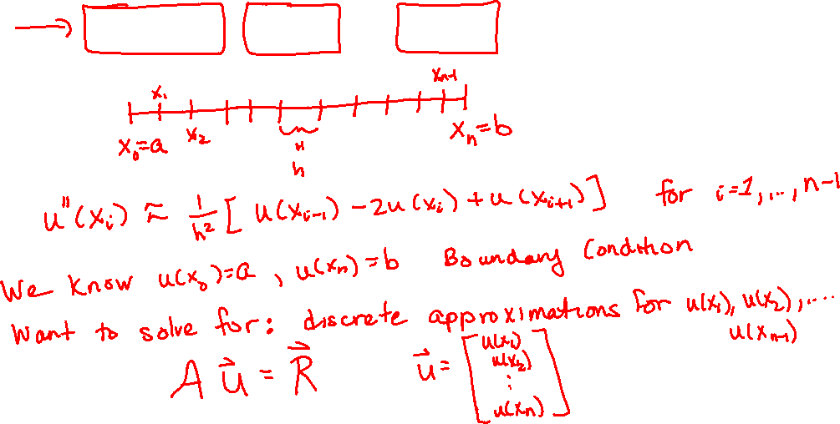
Boundary Value Problem
Boundary Value Problems
Solve for u(x) given the following boundary value problem:
u’’-k²u=0 u(a)=$α$ and u(b)=$β$ a< x < b
Utilize derivative approximations

Slide 7
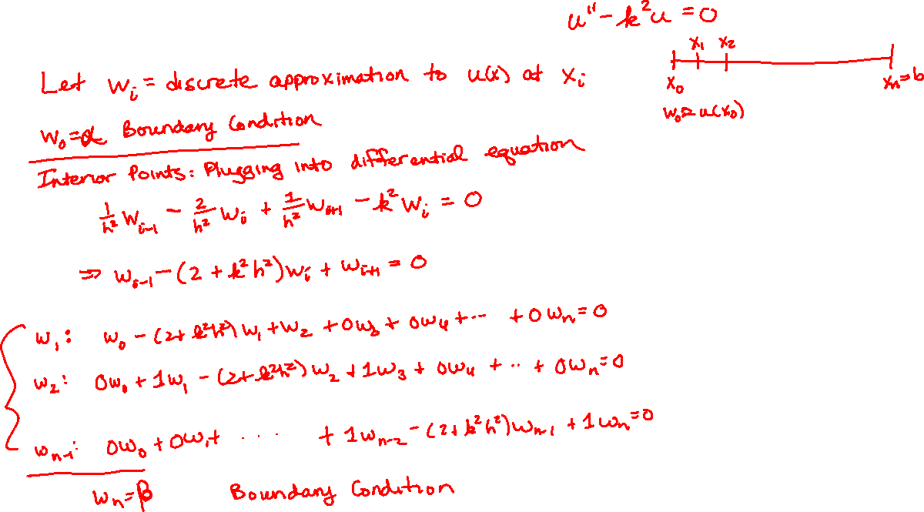
Boundary Value Problem
Boundary Value Problems

Slide 8
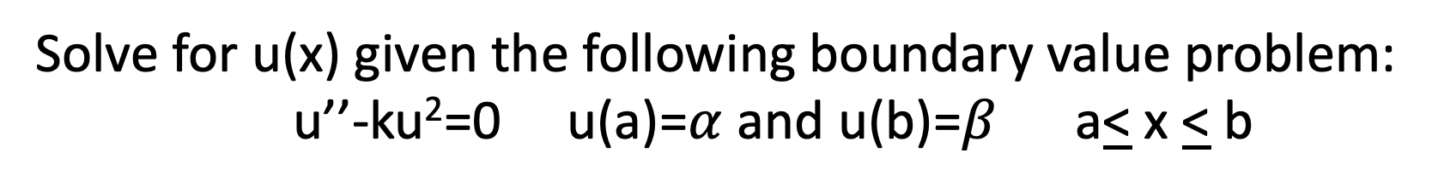
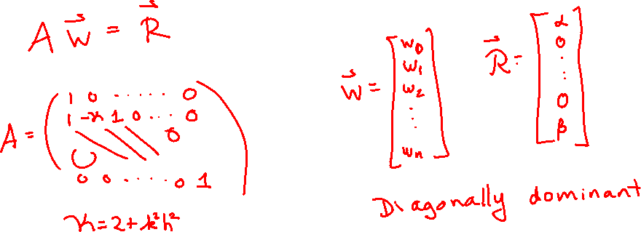
Boundary Value Problem
Boundary Value Problems
Solve for u(x) given the following boundary value problem:
u’’-ku²=0 u(a)=$α$ and u(b)=$β$ a< x < b

Slide 9
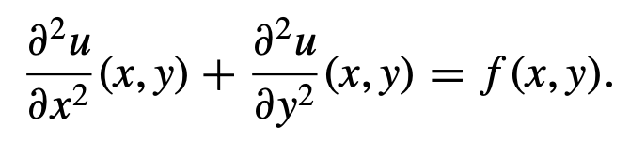
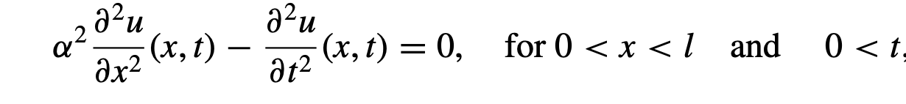

Partial Differential Equations
u(x,t) or u(x,y,t) or u(x,y)
Elliptic PDEs:
Hyperbolic PDEs:
Conditions: Initial and/or Boundary Conditions

Slide 10

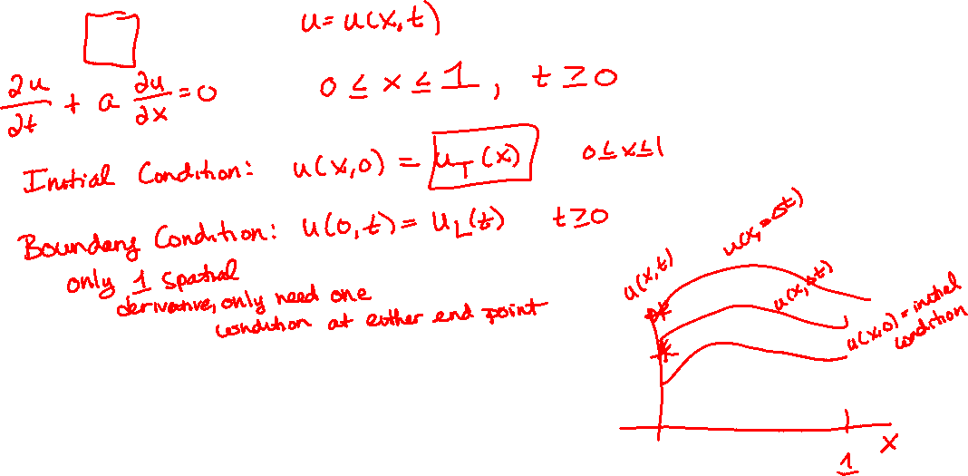
Advection Equation

Slide 11
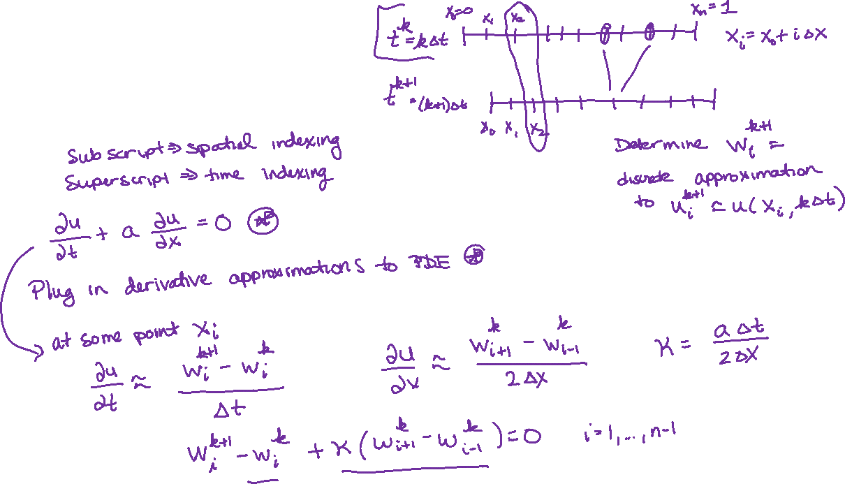
Advection Equation

Slide 12
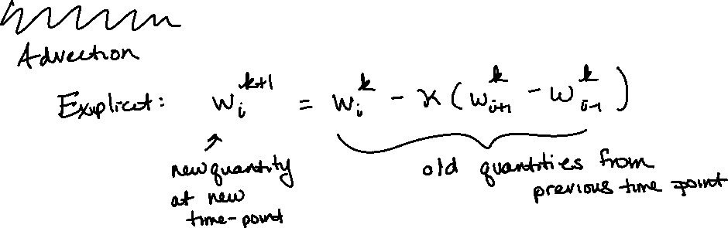
Diffusion Equation

